Slide 1
Bigdata

Slide 2
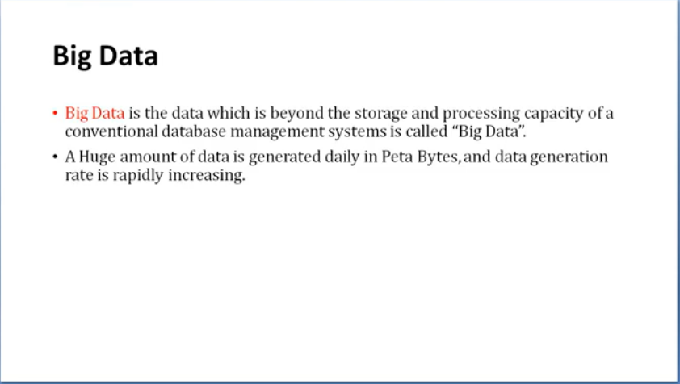

Slide 3
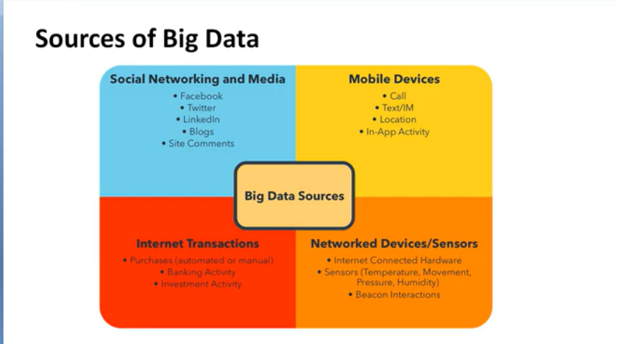

Slide 4
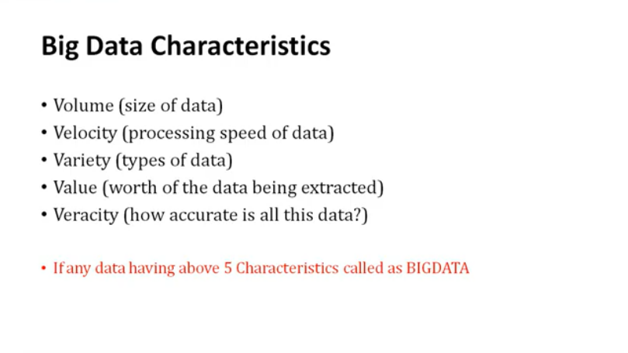

Slide 5
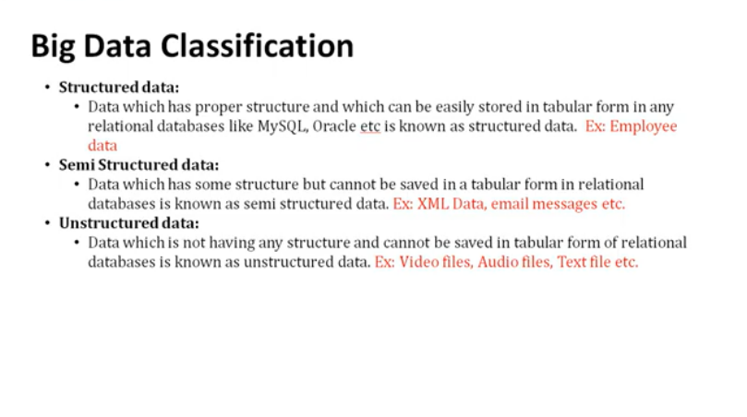

Slide 6


Slide 7
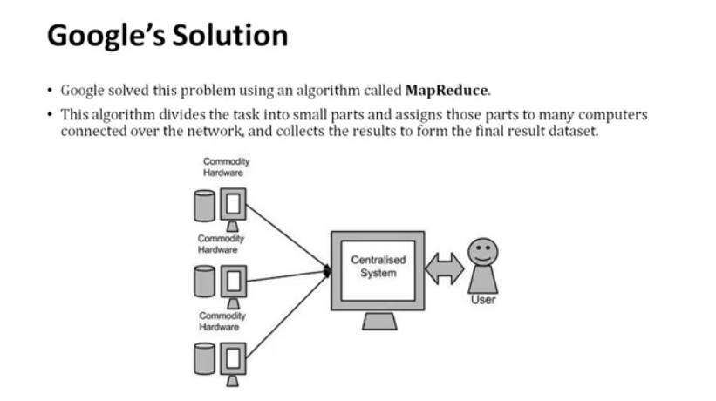

Slide 8
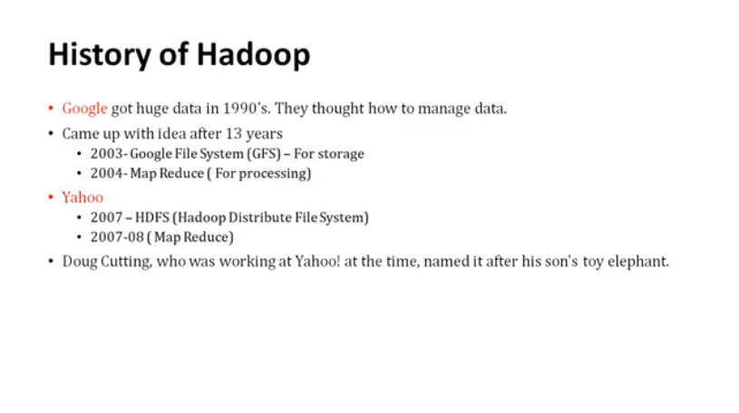

Slide 9
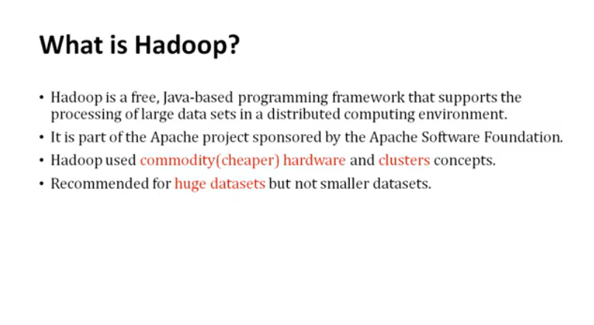

Slide 10
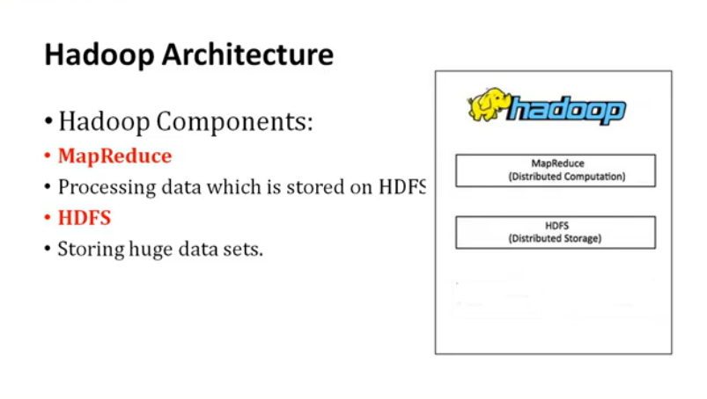

Slide 11
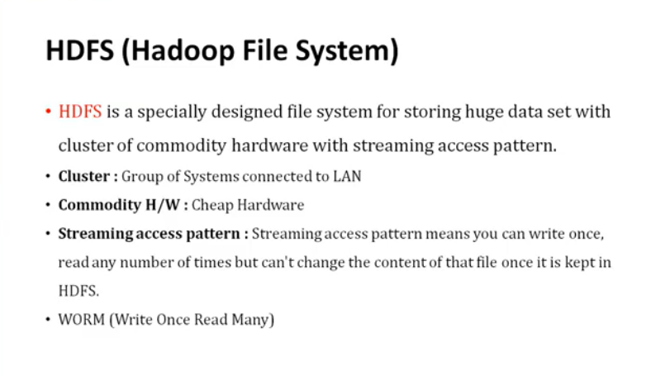

Slide 12
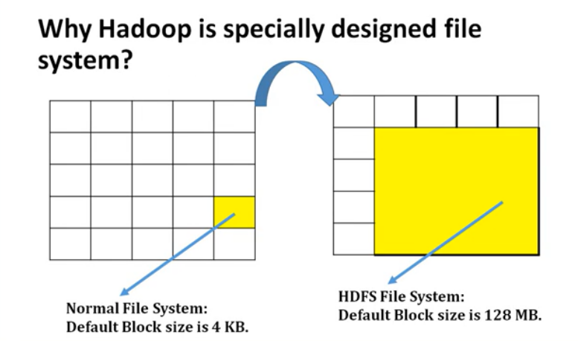

Slide 13
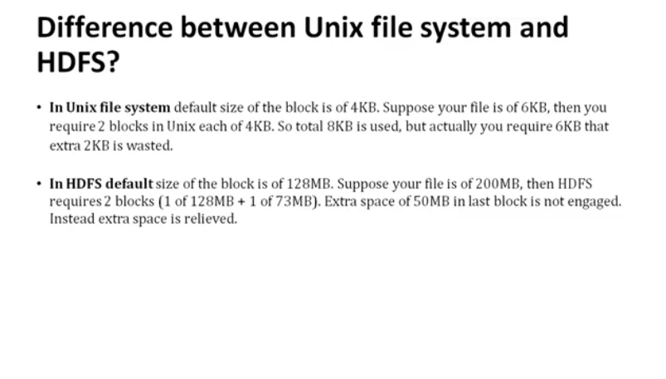

Slide 14
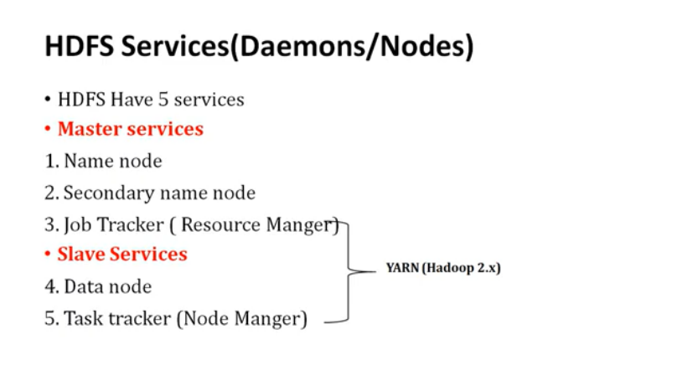

Slide 15
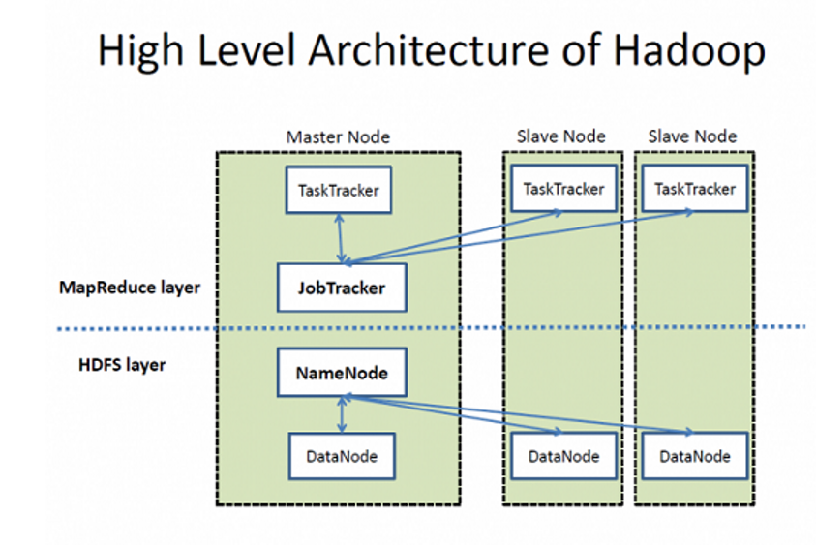

Slide 16
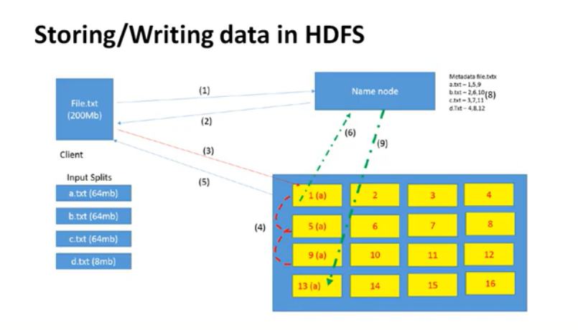
Hadoop 1 block size is 64MB In Hadoop 2 block size 128 MB

Slide 17
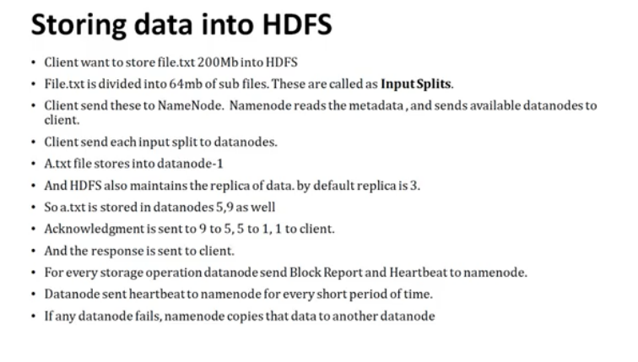

Slide 18
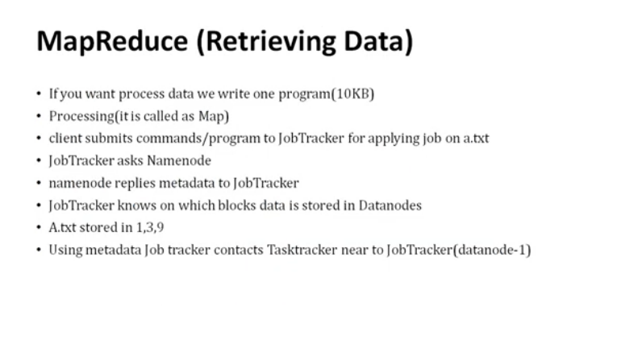

Slide 19
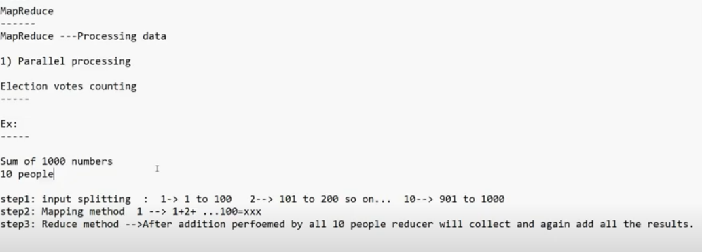
Example

Slide 20
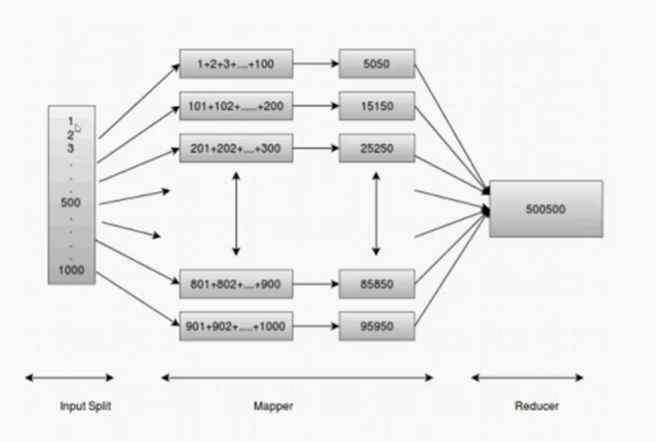
Continue….

Slide 21
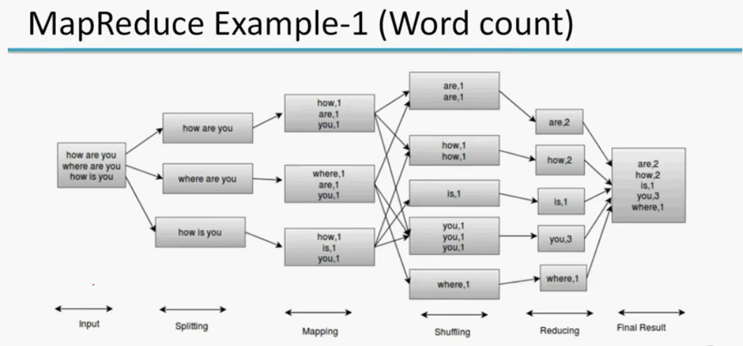
Word Count Example

Slide 22
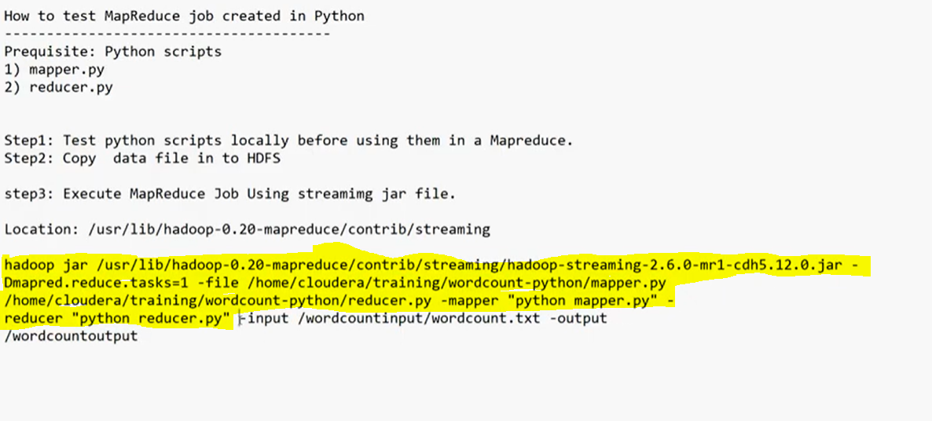
How to test Map reduce Job created in python

Slide 23
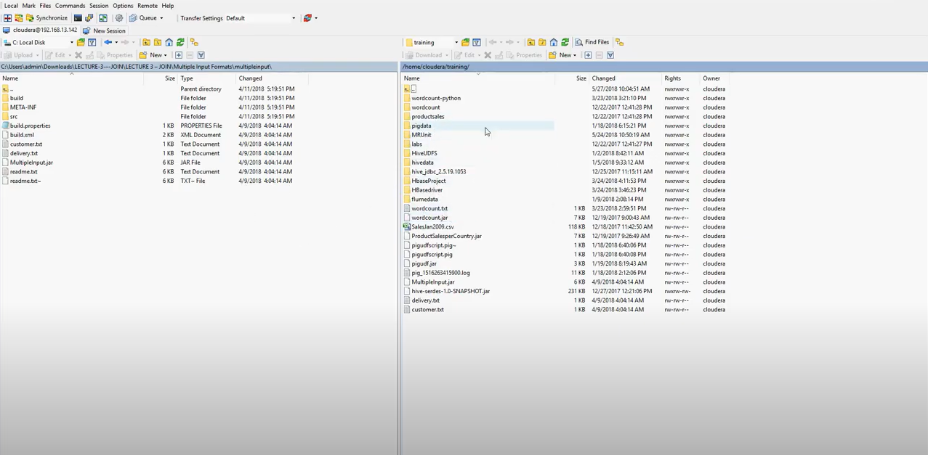
Win Scp – it is used to copy files from widows to unix and vice-versa

Slide 24
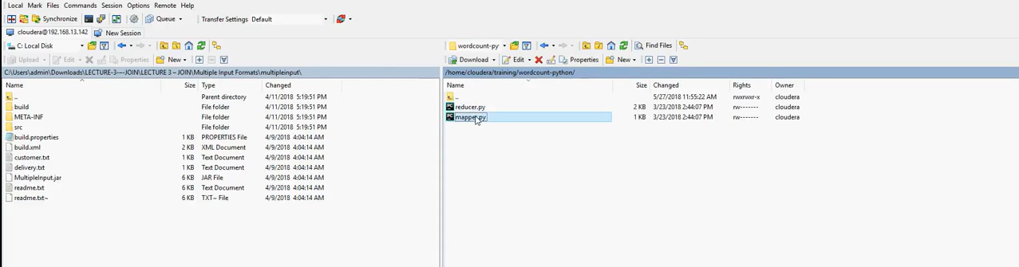
WinSCP

Slide 25
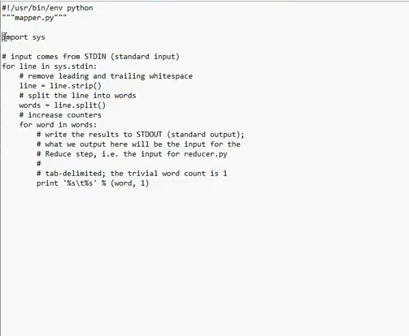
Mapper Script

Slide 26
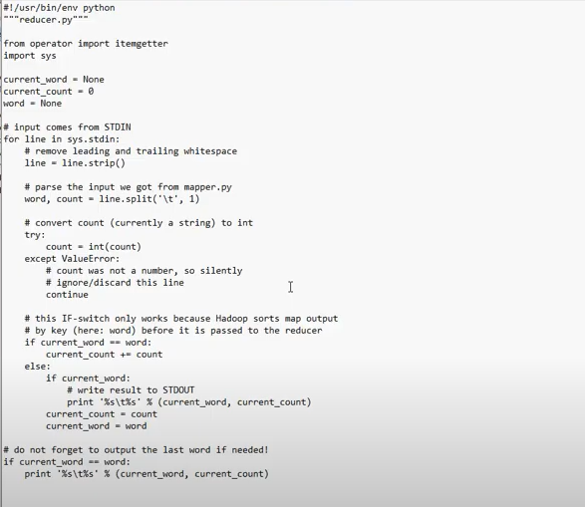
Reducer Script

Slide 27
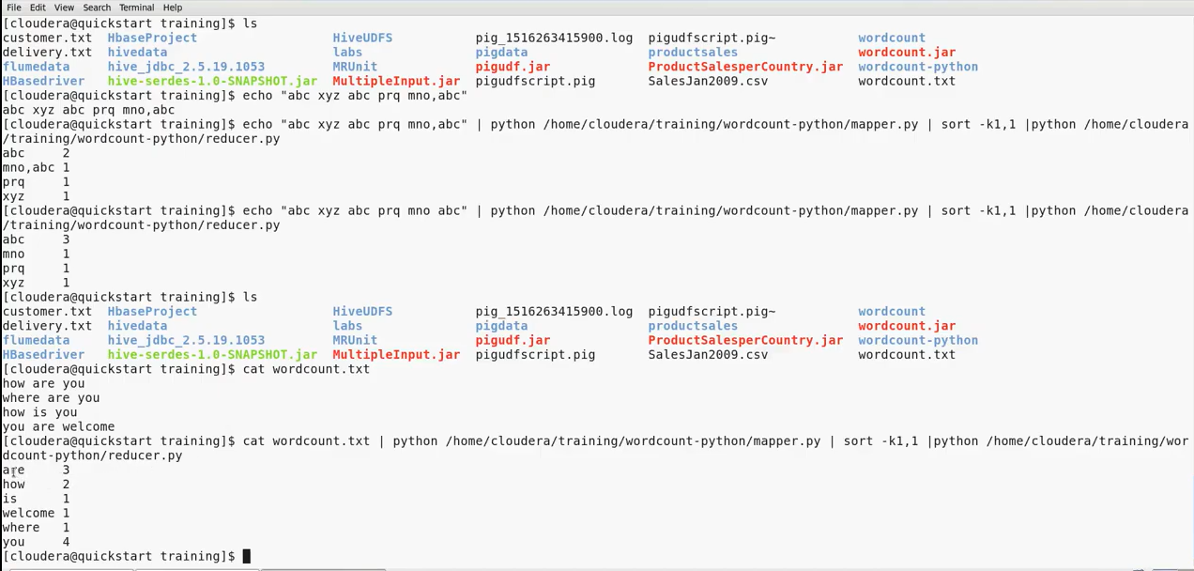
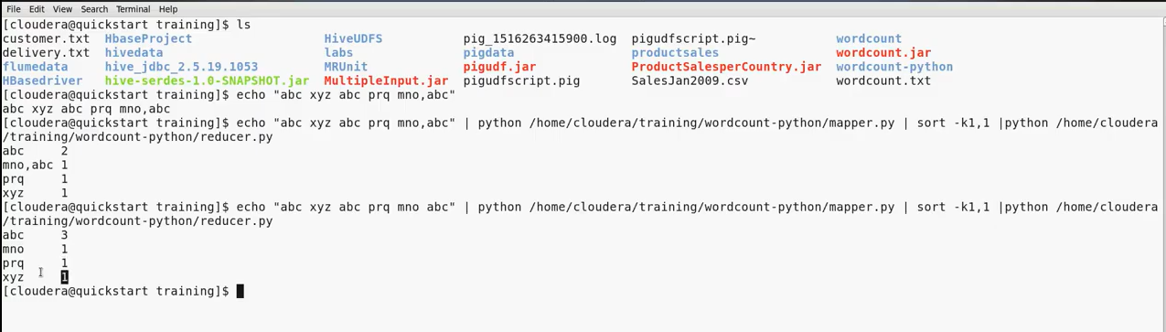

Slide 28
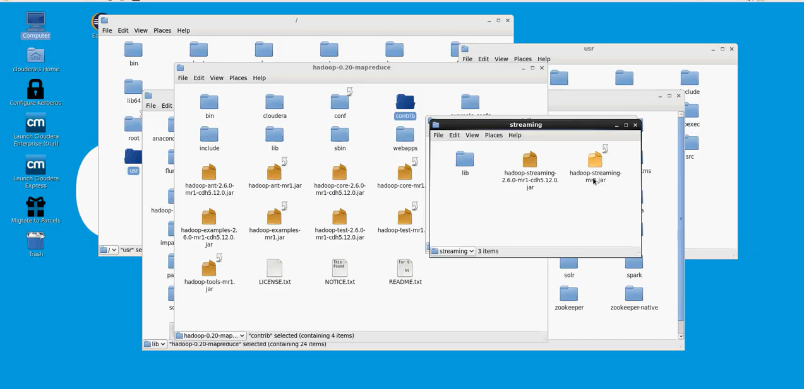
Hadoop jar file Location

Slide 29
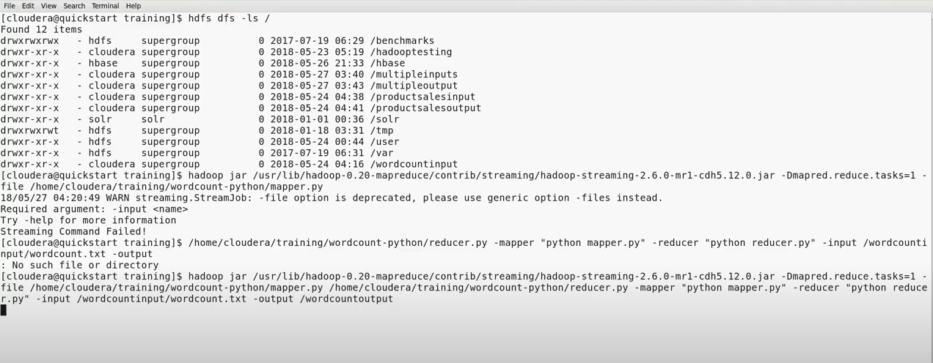
Using Hadoop terminal by using Hadoop commands

Slide 30
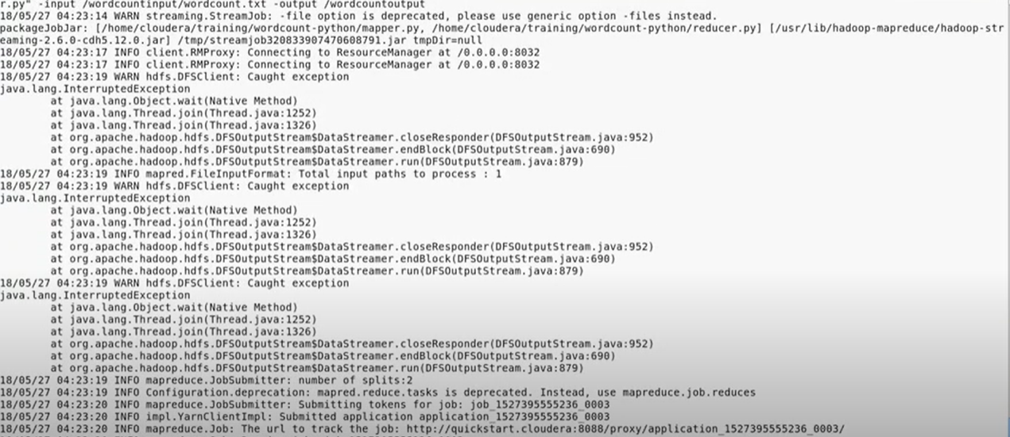

Slide 31
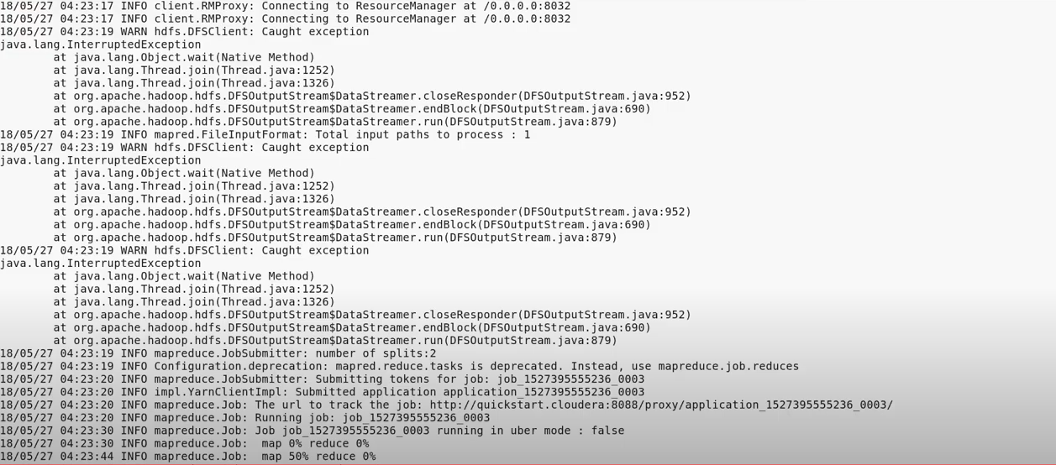

Slide 32
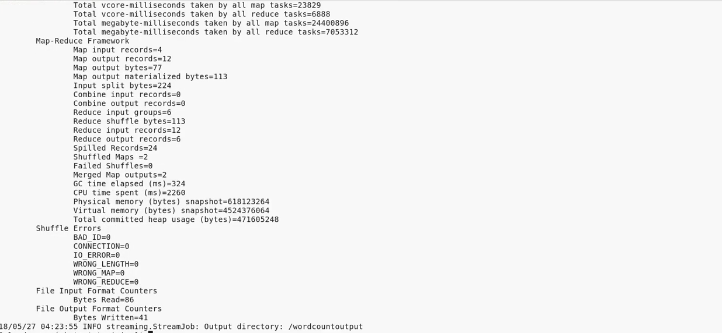

Slide 33
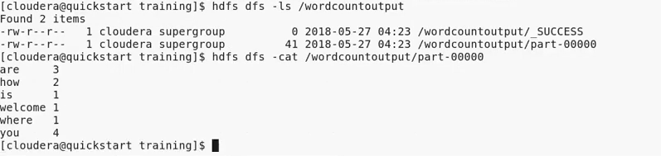

Slide 34
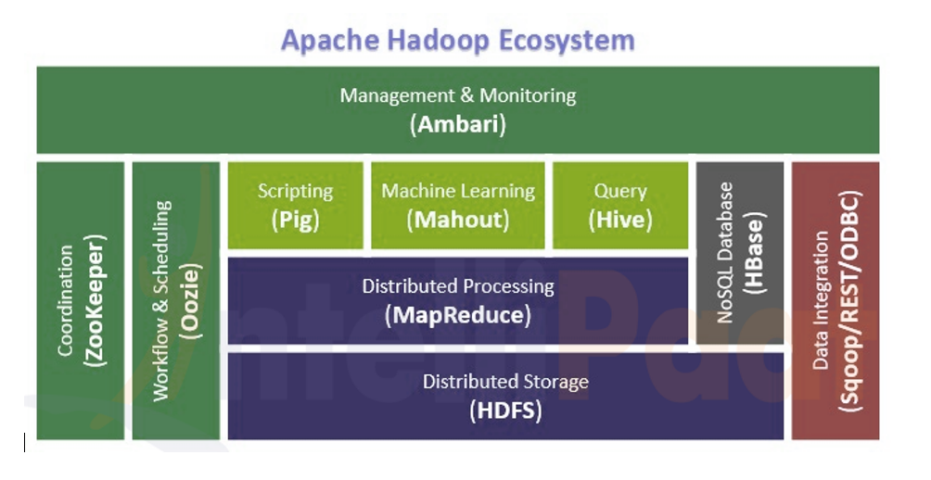
In Hadoop 2.x from onwards which supports YARN . Which helps to connect with different application like pig, Hive etc. Because Of YARN only it is possible to built an Apache Hadoop Ecosystem.

Slide 35
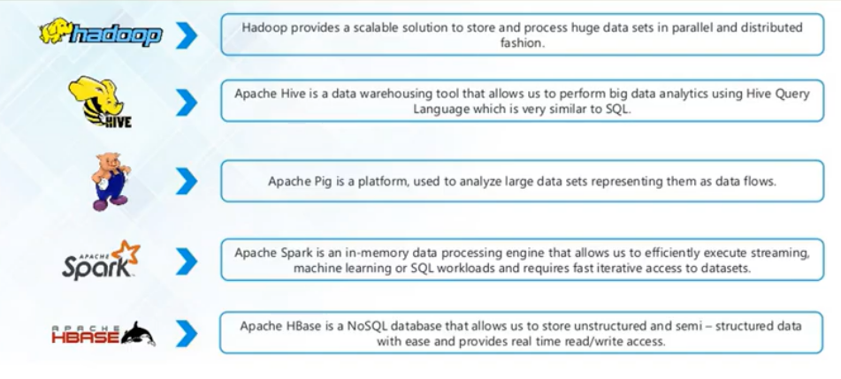

Slide 36
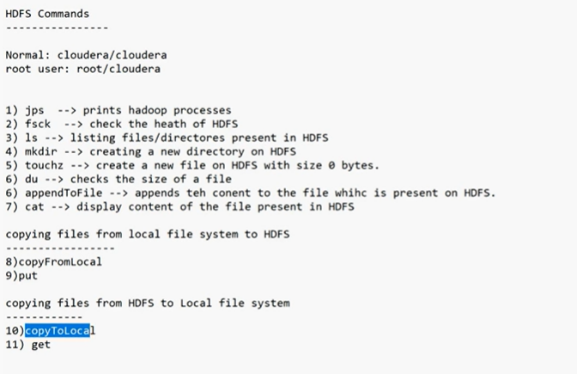
HDFS Commands

Slide 37
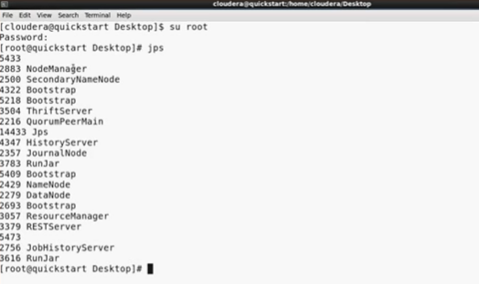
HDFS Commands To Operate any Hadoop commands we need to use always hdfs dfs –command 1.JPS(Java Processes Status) JPS will show whether all the Hadoop services are up and running or not and print all the Hadoop processes.

Slide 38
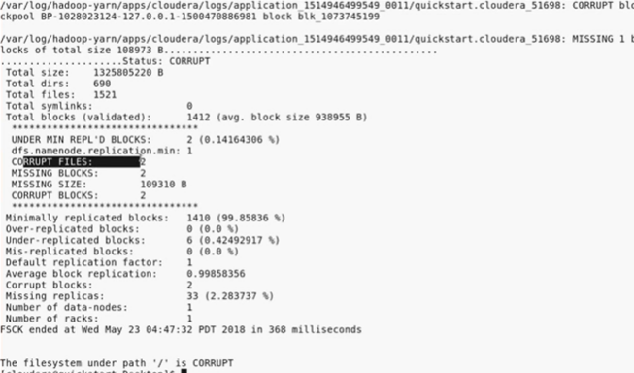
2.Fsck(File System Check) → Check the health of HDFS

Slide 39
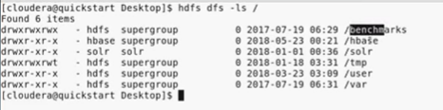
Always in Hadoop we need to use hdfs dfs along with Linux command –ls for normal Linux.

Slide 40
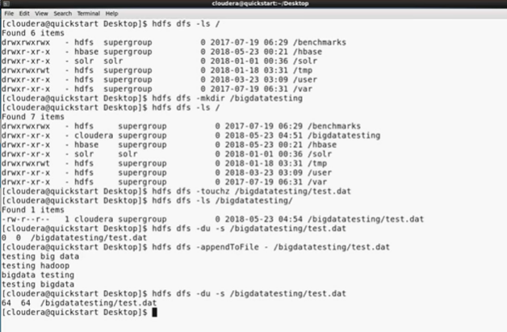

Slide 41
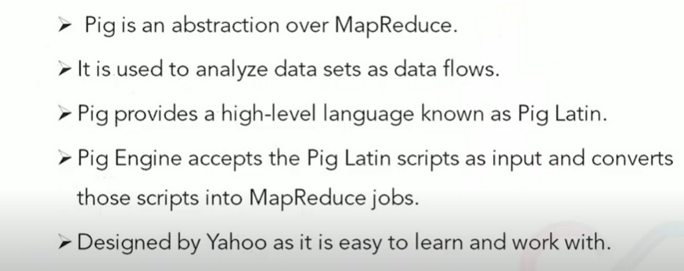
Pig Overview

Slide 42
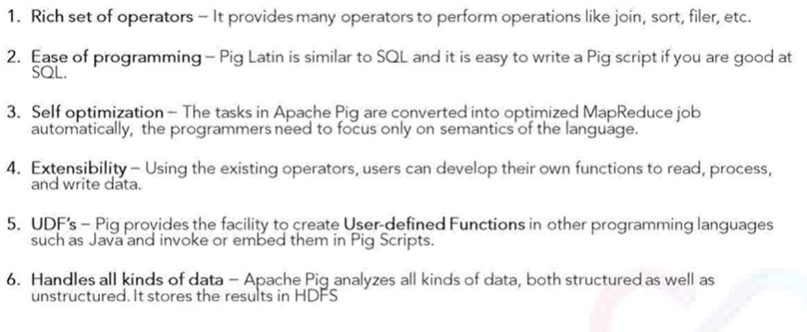
Pig Features

Slide 43
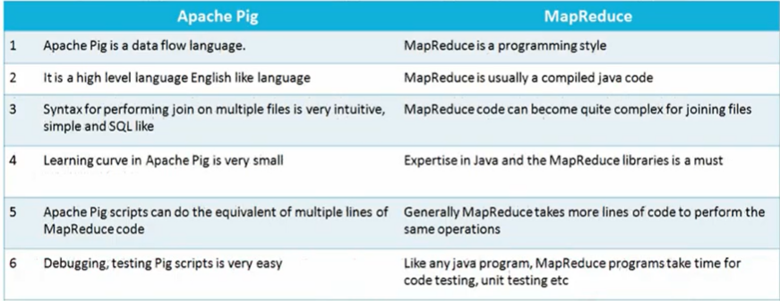
Pig v/s Map Reduce

Slide 44
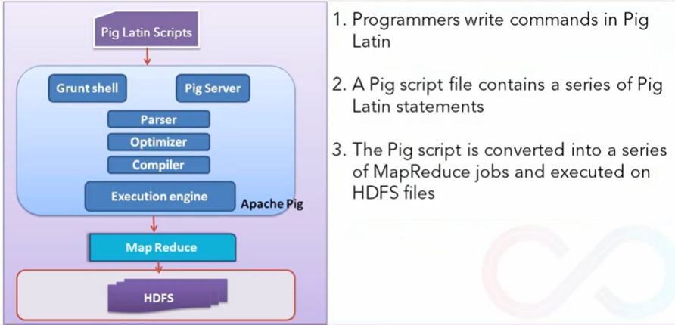
Pig Architecture

Slide 45
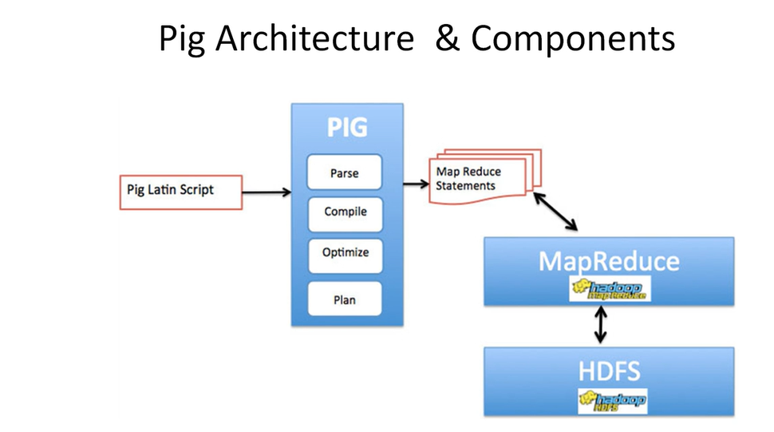
Continue…

Slide 46
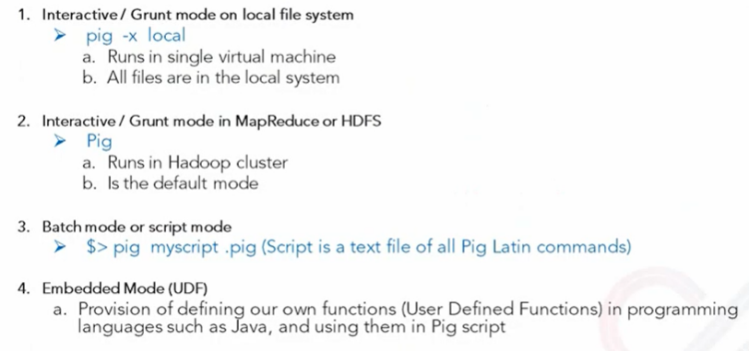
Pig Execution mode

Slide 47
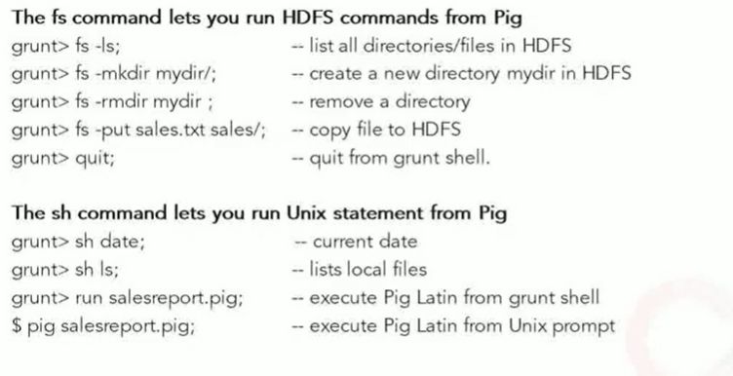
Basic Commands

Slide 48
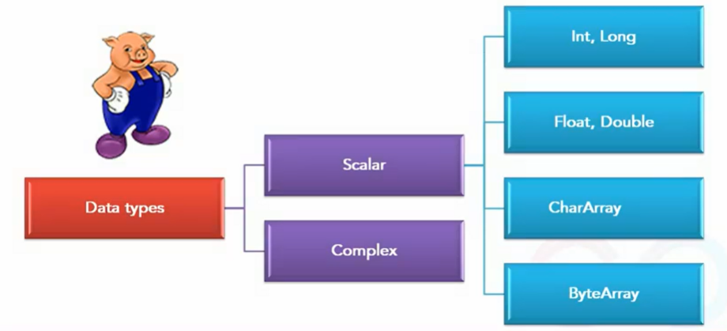
Pig Data Types

Slide 49
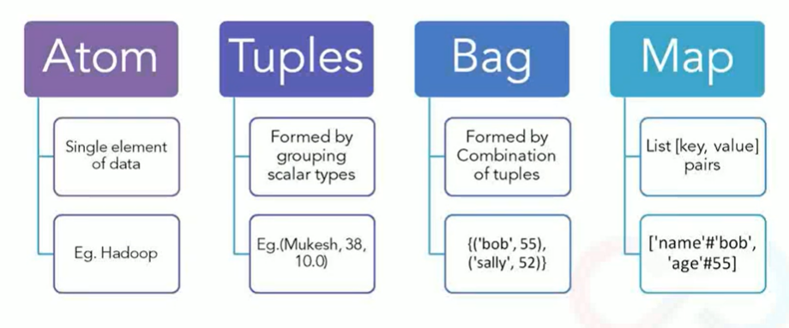
Complex Data Type

Slide 50
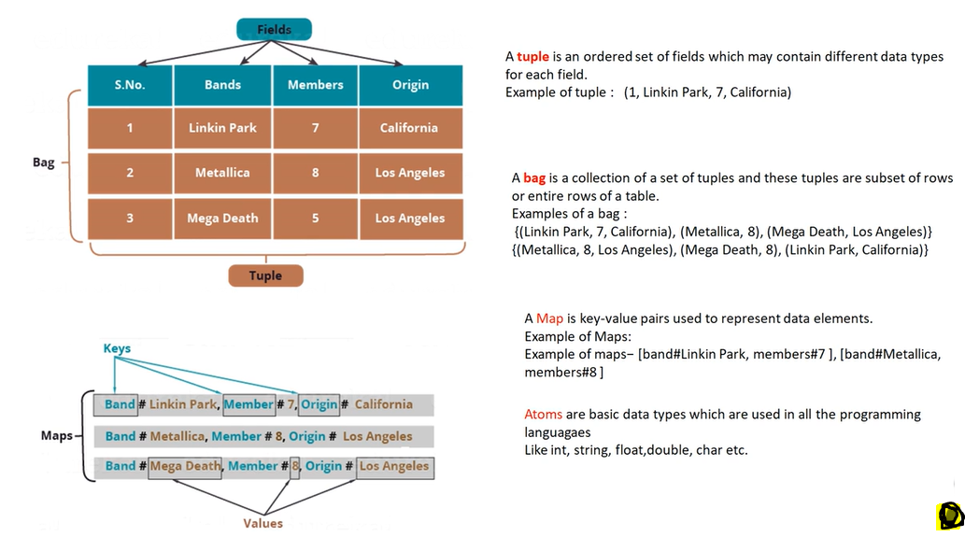

Slide 51
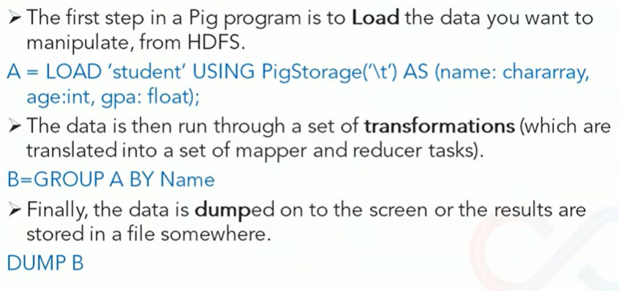
Pig Commands Ex

Slide 52

Script Example Write pig script Calculate those employees who work less than 20 hours and display in descending order

Slide 53

Write pig script Calculate those employees who work less than 20 hours and display in descending order

Slide 54

Script

Slide 55


Slide 56

Run output.pig

Slide 57

Output

Slide 58

Hive

Slide 59


Slide 60


Slide 61

Hive Data Flow

Slide 62


Slide 63


Slide 64


Slide 65


Slide 66


Slide 67


Slide 68


Slide 69
INTERNAL OR MANAGED TABLE EXTERNAL TABLE
1.By default, Hive creates an Internal or Managed Table. 1.Use EXTERNAL option/clause to create an external table
2.Hive owns the metadata, table data by managing the 2.Hive manages the table metadata but not the underlying file. lifecycle of the table.
3.Dropping an Internal table drops metadata from Hive 3.Dropping an external table drops just metadata from Meta store and files from HDFS. Meta store with out touching actual file on HDFS.
4.Hive supports ARCHIVE, UNARCHIVE, TRUNCATE, 4.Not supported.
MERGE, CONCATENATE operations.

Slide 70


Slide 71


Slide 72


Slide 73


Slide 74

Aginity Pro

Slide 75


Slide 76


Slide 77
END

